Slide 2
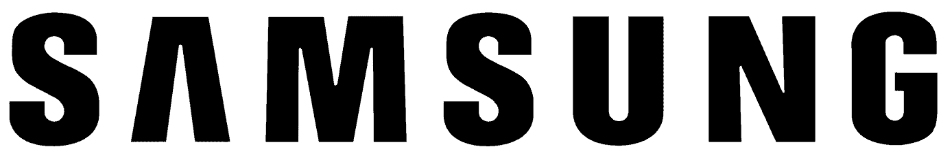
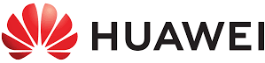
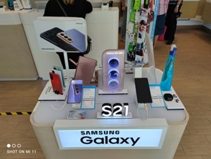
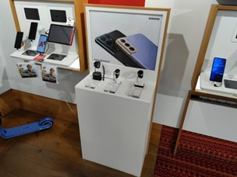
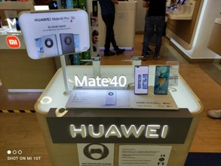
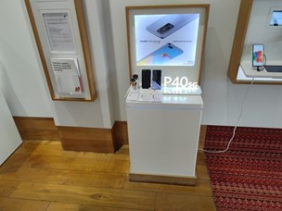
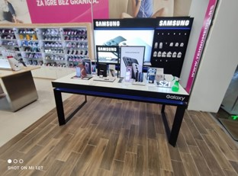
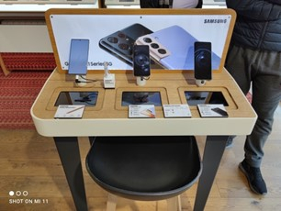
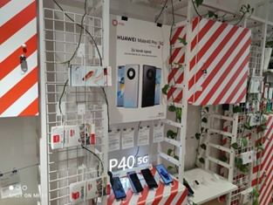
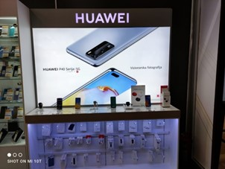
Competitor Analysis – Balkan region
Team structure (RS, MNE, MKD, AL, BIH):
  34 promoters
  13 merchandisers
  2 trainers
Sales positions in all partner channels (OM and Telco)
Team structure (RS, MNE, BIH):
  17 promoters
  9 merchandisers
  2 trainers
Sales positions in all partner channels (OM and Telco)

Slide 3
Media consuming - overview
MKT summary
37%
listen to radio every day
85%
watch TV every day
Television is convincingly, but also as expected, the type of media that follows the largest number of respondents - less than 3% of population in general does not consume this media
The period of the day in which it is followed by as many as 3/4 of consumers is between 20 and 24 hours
In addition to music, the contents that consumers of this media most often follow are news, weather forecast and road conditions
Men will watch these contents more often on the radio than women
The radio is usually listened from 06:00 to 16:00
Top two stations: Radios S1 and Naxi

Slide 4
Media consuming - overview
MKT summary
40%
follow online portals every day
11%
read print news every day
Rural residents and respondents over the age of 60 are more likely to buy newspapers on a daily basis
Consumers of this type of media most often read it in situations when they want to follow the news (38%), when they have nothing else to do (29%) and in waiting rooms (24%).
The contents searched by 1/3 of consumers of this format are sports and events in domestic politics, while 1/4 on portals search local news from their city or region
more than 50% of visitors are between 25 and 50 years old

Slide 5
Media consuming - overview
MKT summary
69%
use mobile apps for informations
8%!!!
follow podcasts
The period of the day during which 1/3 of consumers use applications is from 6 am to 12 noon.
Most audience are workpeople and from urban region
The YouTube platform is absolutely dominant for tracking podcasts
41% of podcast audiences are between 18 and 25 years old
What podcast and YT show followers have in common is that the content of what they follow is, in most cases, more important than the creators on these platforms

Slide 6
Media consuming - overview
MKT summary
SoMe facts:
Every 8th respondent claims not to use social networks for information purposes
Half of the respondents use Facebook, every third Instagram for information
20% of respondents trust the information published by the official media more
Which sources do you trust more (social networks vs official sources)?
I do not know
I don't trust either of them
I trust them equally
I trust the official ones more
media
I believe more in society
networks
7%
38%
19%
20%
16%

Slide 7
Media consuming - overview
MKT summary
Television is an absolutely dominant media format
The radio has its purpose and a very loyal audience
The print media still survives, but new digital media formats are approaching them
Internet portals and applications have taken over a part of the audience of daily newspapers
Podcast - a format of great potential for narrowly focused communication
Confidence in the official media is still higher than in social networks

Slide 8
Media consuming – per TA
MKT summary
TA 1: 14 – 18 yo
SoMe 80%
TikTok,YT and podcasts 60%
Online portals 15%
Other media (TV, print) 5%
TA: 19 – 24 yo
SoMe 40%
Ig,FB and YT 60%
Online portals 30%
TV 20%
TA: 25 – 45 yo
Online portals 40%
TV 30%
SoMe 20 %
IG, FB and YT
*lot of time in traffic during day – OOH campaigns for this TA

Slide 9
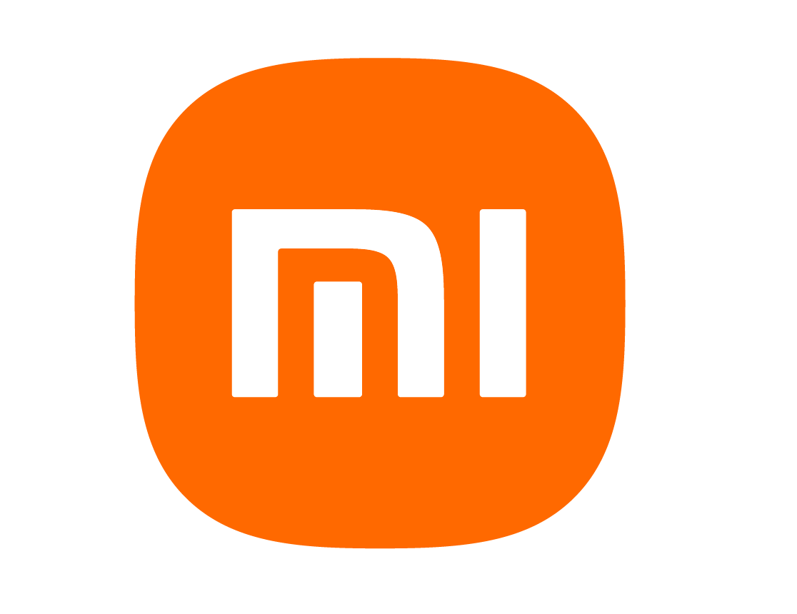
Share of voice report
MKT summary
Share of voice report shows us the H1 2021 trends in media related to the popular mobile phone brands.
Mentions include any piece of coverage, article, note, quote of the brand, in any context. For Samsung, additional analysis showed that only 58% of the mentions were mobile phone related, so the total number is adjusted accordingly.
Data is compiled from multiple sources that are available in order to show the best macro view of the media coverage when top mobile brands are in question.
Brand | Mentions in media
Samsung | 1.888*
Huawei | 1.413
Xiaomi | 1.083
VIVO | 56
Grand Total | 4.293
*Excluded mentions of other products from the report. Analytics show that 58% of total Samsung mentions (3,225) are mobile phone related.

Slide 10
Share of voice report
MKT summary
As we can see from the chart below while Samsung has a relatively steady number of mentions during the first half of the year, we can se Xiaomi gaining traction in the month of May with more mentions than Samsung, but still lower than the optimal month of Samsung (example January and April). Trend is however positive, and it is expected to rival Samsung in the total mentions in the H2 of the year.
Huawei have fully organic steady number of mentions, since media writing about their fall and reworked strategy.
BRAND | January | February | March | April | May | Grand Total
Samsung | 479 | 285 | 392 | 400 | 332 | 1.888*
Huawei | 262 | 211 | 353 | 298 | 289 | 1.413
Xiaomi | 187 | 145 | 167 | 232 | 352 | 1.083
VIVO | 10 | 5 | 18 | 15 | 8 | 56
Grand Total | 938 | 646 | 995 | 880 | 981 | 4.440
*Excluded mentions of other products from the report. Analytics show that only 58% of total Samsung mentions (3,225) are mobile phone related.

Slide 11
Share of voice report
MKT summary
Graphical view shows us the trend even more clearly. Xiaomi had the biggest positive trend month over month in the first half of the year. It is our expectation for all brands to traditionally drop in Q3, before the rise in Q4 of 2021.

